Slide 1
Unit 3A
Human Form & Function
Cells, metabolism & regulation
Homeostasis

Slide 2

Study Guide
Read:
Our Human Species (3rd edtn)
Chapter 6
Complete:
Human Biological Science Workbook
Topic 3 – Homeostasis

Slide 3
Homeostasis
Definition
Homeostasis is the process whereby the body’s internal environment is maintained in a steady state (i.e. within normal tolerance limits).

Slide 4
The internal environment
An adult’s body contains about 14 L of tissue fluid (also known as interstitial fluid).
Tissue fluid:
  bathes ALL cells
  represents the cell’s immediate environment
  provides optimum conditions for cell function.

Slide 5
What is homeostasis?
The body works best within a narrow range of conditions e.g. body temperature, fluid content.
If conditions inside the body start to change the body automatically switches on control mechanisms that restore the optimal operating environment
e.g. if our temperature goes up we sweat; if we lose too much fluid we feel thirsty.
The ability to maintain the body’s optimal working environment is referred to as homeostasis.

Slide 6
Why is homeostasis important?
Homeostasis maintains conditions under which cells perform most efficiently.
Under normal circumstances the properties & composition of tissue fluid DO NOT change very much, regardless of the external environment, or what we are doing.

Slide 7
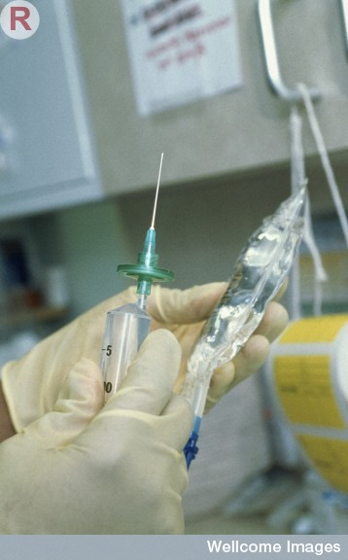
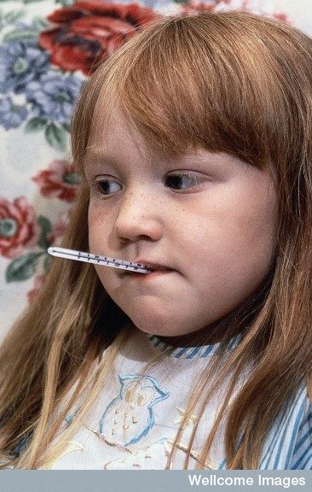
If the properties of the tissue fluid cannot be maintained within tolerance limits, the cells cannot function properly – consequently, we are likely to get sick and may even die.
Wellcome Photo Library

Slide 8
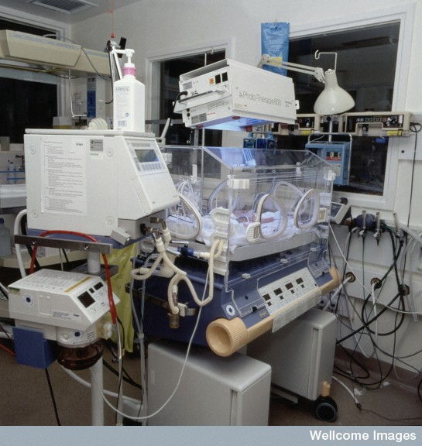
Intensive care
An incubator plus monitoring and life support equipment in a special care baby unit helps premature babies, or new-born babies with life-threatening conditions, to establish homeostatic balance.
Wellcome Photo Library

Slide 9
Examples of properties of tissue fluid which must be maintained in homeostatic balance
body temperature
blood pressure
fluid concentrations (osmotic, diffusion and electrochemical gradients)
acidity (pH)
the concentration of nutrients, wastes and gases.

Slide 10
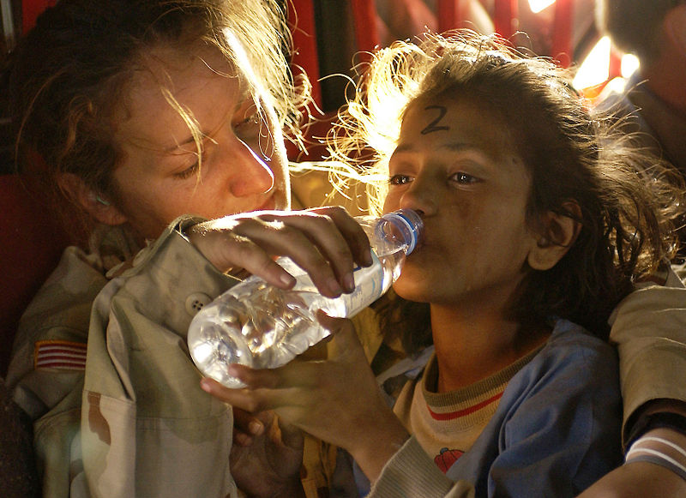
Living things adapt to their environment – often by performing homeostatic processes
Young refugee being rehydrated

Slide 11
Tolerance limits
The range of conditions in which the body can function are referred to as its tolerance limits.
If conditions change beyond the tolerance limits, body systems cannot function properly, and we get sick and may even die.

Slide 12
Body temperature
Normal range
Death
Below tolerance limit
37˚C
Above tolerance limit
Death
Hypothermia
Hyperthermia/heatstroke
Blood pressure
Death
120/80 mm Hg
Death
Shock
Hypertension
Blood glucose
Death
3.5 – 8 mmol/L
Death
Hypoglycemia
Hyperglycemia/ Diabetes

Slide 13

Homeostatic balance
If our body temperature gets too high we sweat and this returns our temperature to a safe level.
If we get too cold we shiver and this produces extra body heat.

Slide 14
Steady state control mechanisms
The body processes responsible for maintaining homeostatic balance are called steady state control mechanisms.

Slide 15
Examples of steady state control mechanisms
Steady state control process | Maintains homeostatic balance of
Sweating/shivering Vasodilation Vasoconstriction | Body temperature
Breathing rate | Oxygen & carbon dioxide levels pH
Cardiac output | Most homeostatic functions
Kidney function | Getting rid of wastes Fluid balance pH

Slide 16
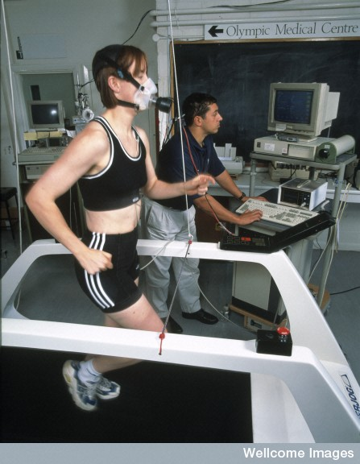
During exercise we breathe harder and our heart beats faster to maintain the correct balance of oxygen and carbon dioxide.
. Female athlete having cardiovascular fitness tested
Wellcome Library, London

Slide 17
The feedback model
Steady state control processes are regulated by feedback mechanisms
Feedback mechanisms are self-regulating control processes (i.e. we do not control them consciously) because the response continually modifies the stimulus.
These feedback processes are referred to as feedback loops.

Slide 18
Negative feedback and homeostasis
Homeostasis is maintained by means of negative feedback.
i.e. the response neutralises or reverses the original stimulus.
e.g. when we are too hot sweating cools us down so there is no longer any stimulus to activate the sweating mechanism.

Slide 19
Negative feedback loop
Stimulus
Receptor
Control
centre
Feedback
Response
Effector

Slide 20
Negative feedback loop
Core temperature
> 37˚C
Thermoreceptor
Stimulus
Receptor
Thermoregulatory centre in brain
Core temperature
lowered to 37˚C
Control
centre
Feedback
Response
Effector
Sweating initiated
Sweat glands

Slide 21
Conscious responses to environmental change
We can respond consciously to external change in order to maintain homeostatic balance
e.g. if we feel too hot we can choose to move away from the heat source or remove clothing.
Such conscious responses are described by the stimulus-response model.

Slide 22
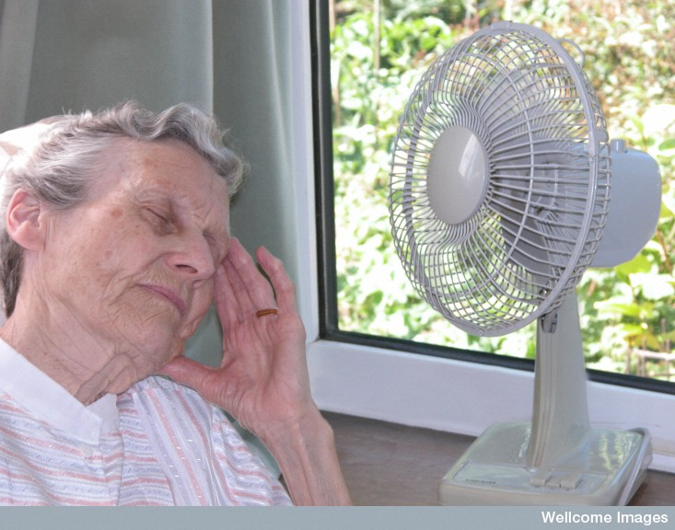
Stimulus-response
When external conditions threaten our wellbeing be can make a conscious decision to take appropriate action.
Libby Welch, Wellcome Images

Slide 23
Stimulus-response model
Stimulus
Receptor
Control
centre
Response
Effector

Slide 24
Stimulus-response model
Hot external temperature
Thermoreceptor
Stimulus
Receptor
Conscious
area of brain
Control
centre
Response
Effector
Move to cooler area
Remove clothing
Turn on fan
Muscles

Slide 25
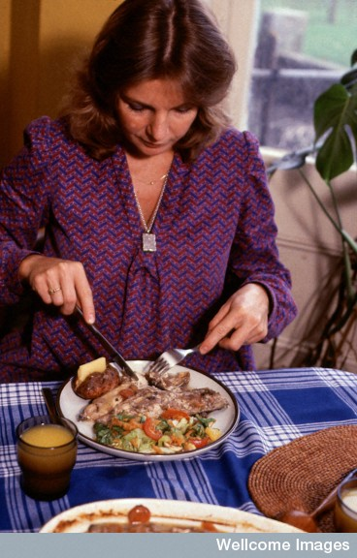

Not everyone has the same tolerance limits
Explain this statement with reference to these two photographs.
Anthea Sieveking, Wellcome Images
Libby Welch, Wellcome Images

Slide 26
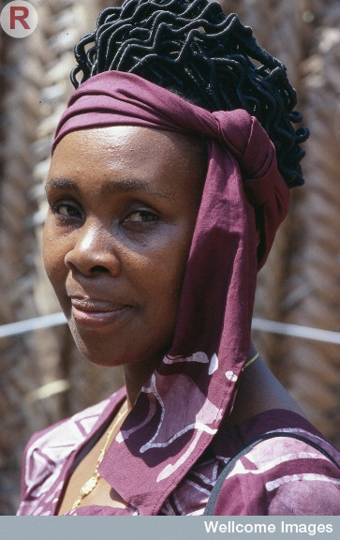
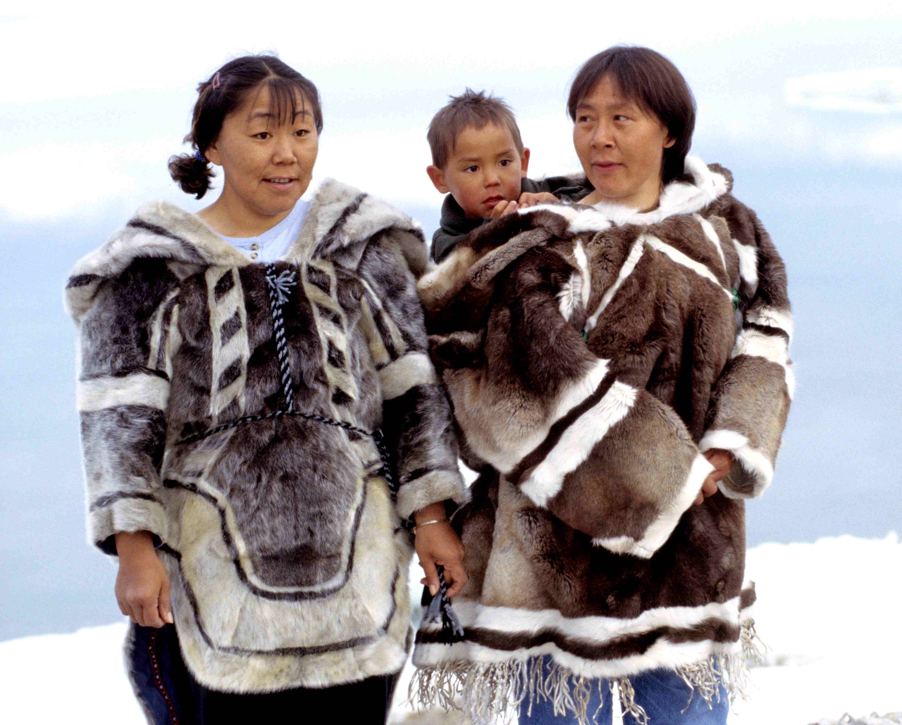
Not everyone has the same tolerance limits
Explain this statement with reference to these two photographs.
Ansgar Walk
N Durrell McKenna, Wellcome Images

